Slide 1
Battle of neighborhoods
Delivered by: Ahmed Mokhtar

Slide 2
Data Section
Data desciption which are collected from the foursquare Api
The data is required to provide adequate information about the Cafes, Restaurants, Shopping malls and sporting clubs.
The data should help me decide where to rent my appartment with good pricing.
The data should help me make the most use out of my time with the top areas to visit and meet by.
Data Usage
Using the geolocator to locate New Cairo Address
get address longitute and latitudes
Use the four square Api with the Client ID and Version to find out the list of venues around a radius area.

Slide 3
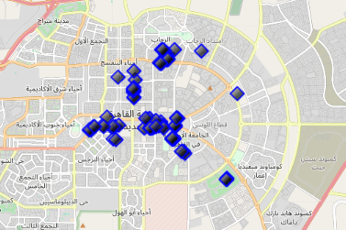
The Neighborhoods Map for the Choosing Area (New Cairo, Egypt)

Slide 4
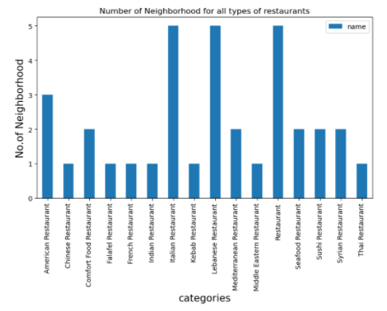
The Number of Restaurants Categories Around the selected District

Slide 5
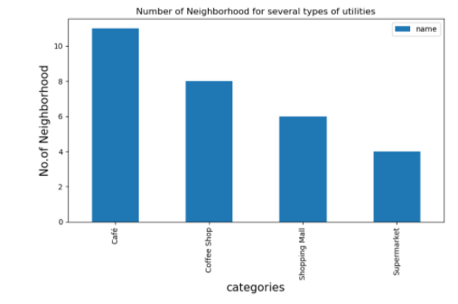
Availability of Categories

Slide 6
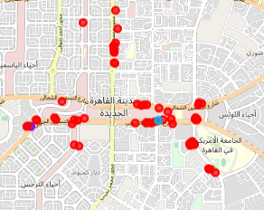
Cluster 0 The Selected Cluster

